Slide 1



Noida Institute of Engineering and Technology, Greater Noida
Introduction to OB
Unit: I
Organizational Behavior
Deepika Sharma
Assistant Professor
MBA Dept
Course Details (MCA INT 5th Sem)

Slide 2

Faculty Introduction
Faculty Name: Deepika Sharma
Designation: Assistant Professor
Department: MBA
Email ID: deepika@niet.co.in
Qualification: Pursuing Ph.D.
Specialization: HR, Marketing
Teaching Area:
Total Experience: 2 Years

Slide 3
Evaluation Scheme

Slide 4
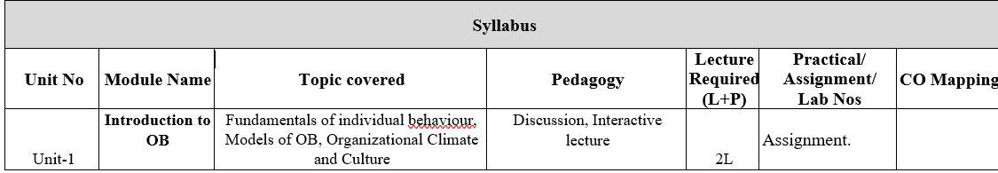
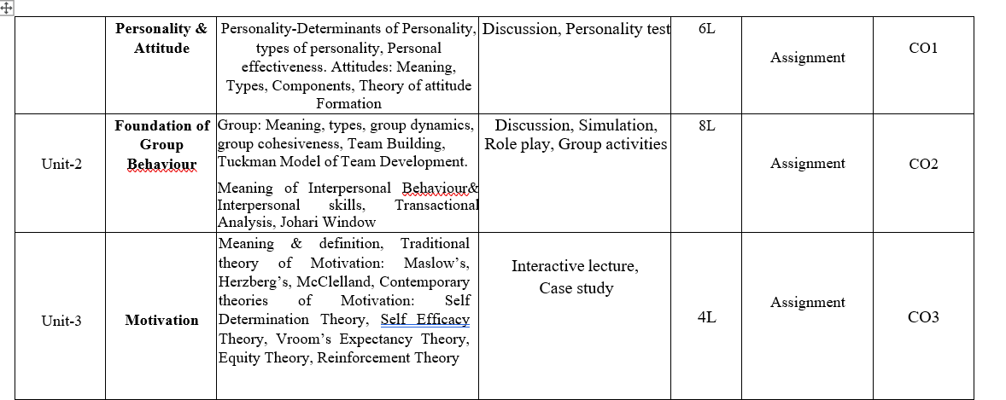
Syllabus

Slide 5
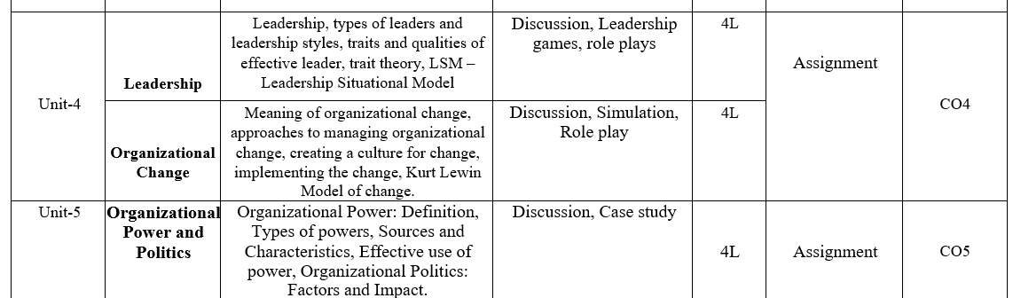
Syllabus

Slide 6
Branch Wise Applications
Being a core subject this subject will help the students gain understanding of the functions and responsibilities of managers. It shall provide students the tools and techniques to be used in the performance of the managerial job. And will also enable them to analyze and understand the complex human behaviour at organization.

Slide 7
Course Objectives
This course explores the theories and concepts of organizational behaviour and their application in the workplace. It covers individual behaviour, group dynamics, and organizational processes to enhance organizational effectiveness. The Organizational Behaviour course focuses on a better understanding of the key factors that determine human behavior in organizations. The course focuses on key factors for understanding the behavior of people in organizational contexts from a socio psychological point of view that play a basic role in people management and that are the basis of any leadership course in the rest of the program.

Slide 8
Course Outcomes

Slide 9
Program Outcomes

Slide 10
CO-PO Mapping

Slide 11
CO-PSO

Slide 12
CO-PEO

Slide 13
Result Analysis
NA

Slide 14
End Sem Question Paper Templete
NA

Slide 15
Prerequisite
Students should have a primary understanding of management thought.
Students should have preliminary knowledge of organizational Behaviour.

Slide 16
Brief subject introduction
Management comprises planning, organizing, staffing, leading or directing, and controlling an organization to accomplish a goal. It also includes resourcing that encompasses the deployment and manipulation of human resources, financial resources, technological resources, and natural resources. Organizational Behavior (OB) can be defined as the understanding, prediction and management of human behavior both individually or in a group that occur within an organization. Internal and external perspectives are the two theories of how organizational behavior can be viewed from an organization's point of view.
https://www.youtube.com/watch?v=5_btNIdvEfo
https://www.youtube.com/watch?v=Lx83q3mW0oo
https://www.youtube.com/watch?v=uXuj-Kj6_wE

Slide 17
Unit Content
Introduction to OB
Fundamentals of individual behavior, Models of OB
Organizational Climate and Culture
Personality & Attitude
Personality-Determinants of Personality, types of personality
Personal effectiveness. Attitudes: Meaning, Types, Components
Theory of attitude Formation

Slide 18
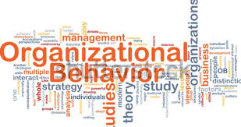
Organizational behavior
Organizational behavior is the study of how individuals and groups interact and how these interactions affect an organization's performance toward its goal or goals.
In words of K Aswathappa, “OB is the study of human behaviour in organisational setting, of the interface between human behaviour and organisation and of the organization itself.”
Notes:
A retail store is having issues keeping its shelves stocked. There are three different departments that influence the shelf stock: floor team, warehouse team, and unload team. The Location supervisor addresses all three teams together to ask them what they think is the cause of the problem. After a long discussion, the warehouse and unload teams take responsibility and work between and within their groups to find a solution. Because the issue was addressed on the group level, this is an example of meso-level organizational behavior.
Macro-level example: A technology company is having trouble with employee retention. The CEO has found that they cannot retain employees for more than 6 months. He decides to re-examine the culture of the company that he had a hand in creating. He found that the culture of the company focused too much on productivity and the employees were becoming dissatisfied. The CEO decides to work with the supervisors to reimagine the company's culture. Because this issue was addressed on a company-wide level, this is an example of macro-level organizational behavior.

Slide 19
Importance of Organizational behavior
It builds better relationships by achieving, people, organizational, and social objectives.
It covers a wide collection of human resources like Behavior, training and development, change management, leadership, teams, etc.
It improves the goodwill of the organization.
It helps to achieve objectives quickly.
It makes optimum utilization of resources.
It improves relations in the organization.
It helps in motivation.

Slide 20
Example of Organizational behavior
A retail store is having issues keeping its shelves stocked. There are three different departments that influence the shelf stock: floor team, warehouse team, and unload team. The Location supervisor addresses all three teams together to ask them what they think is the cause of the problem. After a long discussion, the warehouse and unload teams take responsibility and work between and within their groups to find a solution. Because the issue was addressed on the group level, this is an example of meso-level organizational behavior.
Macro-level example: A technology company is having trouble with employee retention. The CEO has found that they cannot retain employees for more than 6 months. He decides to re-examine the culture of the company that he had a hand in creating. He found that the culture of the company focused too much on productivity and the employees were becoming dissatisfied. The CEO decides to work with the supervisors to reimagine the company's culture. Because this issue was addressed on a company-wide level, this is an example of macro-level organizational behavior.
Notes:
A retail store is having issues keeping its shelves stocked. There are three different departments that influence the shelf stock: floor team, warehouse team, and unload team. The Location supervisor addresses all three teams together to ask them what they think is the cause of the problem. After a long discussion, the warehouse and unload teams take responsibility and work between and within their groups to find a solution. Because the issue was addressed on the group level, this is an example of meso-level organizational behavior.
Macro-level example: A technology company is having trouble with employee retention. The CEO has found that they cannot retain employees for more than 6 months. He decides to re-examine the culture of the company that he had a hand in creating. He found that the culture of the company focused too much on productivity and the employees were becoming dissatisfied. The CEO decides to work with the supervisors to reimagine the company's culture. Because this issue was addressed on a company-wide level, this is an example of macro-level organizational behavior.

Slide 21
Scope of Organizational behaviour
Personality
Perception
Attributes & Values
Motivation
Emotion & Emotional Intelligence
Notes:
Personality
Personality refers to the unique set of traits, characteristics, and patterns of behavior that distinguish one individual from another. Personality traits such as extraversion, agreeableness, conscientiousness, openness, and neuroticism influence how individuals perceive and interact with their environment, colleagues, and tasks.
Perception
Perception involves how individuals interpret and make sense of the world around them. Perceptual processes such as selective attention, interpretation, and attribution shape individuals' understanding of events, situations, and interactions. Perceptions influence decision-making, problem-solving, and interpersonal relationships in the workplace.
Attitudes and Values
Attitudes are individuals' evaluations, feelings, and beliefs about people, objects, or events, while values are enduring beliefs and principles that guide individuals' behavior and preferences. Attitudes and values influence employees' motivation, job satisfaction, commitment, and organizational citizenship behavior.
Motivation
Motivation refers to the internal processes that drive individuals to pursue goals, exert effort, and achieve desired outcomes. Motivational theories such as Maslow's hierarchy of needs, Herzberg's two-factor theory, and expectancy theory help explain individuals' motivation and behavior in the workplace.
Emotions and Emotional Intelligence
Emotions play a significant role in influencing individuals' behavior, decision-making, and interpersonal interactions. Emotional intelligence, which encompasses the ability to recognize, understand, and manage one's own emotions and those of others, is crucial for effective leadership, teamwork, and conflict resolution.

Slide 22

Applications of OB in management
Responding to Globalization
Managing workforce diversity
Improving quality & productivity
Improving people skills
Stimulating Innovation and Change
Work-life balance
Notes:
WFD- the collective mixture of employees’ differences and similarities.

Slide 23
Daily Quiz
Organisational behaviour is_______
a) A science
b) An art
c) A science as well as an art
d) None of the above
A study of the culture and practises in different societies is called _____
a) Personality
b) Anthropology
c) Perception
d) Attitudes

Slide 24
Daily Quiz
In present context, challenges for Organizational Behaviour are _____
a) Employee expectation
b) Workforce diversity
c) Globalization
d) All of the above
The term ‘psychology’ is derived from the word ‘psyche’, which means ‘soul’ or ‘spirit’_______
a) Latin
b) French
c) Greek
d) None of these

Slide 25

Globalization
Globalization is the process that improves interaction by integrating society, culture, politics, and business worldwide. Globalization is the integration of any market with the global economy.
In short, Globalization refers to the complex economic networks of international competition, resource suppliers, and product markets.

Slide 26
Globalization
Before globalization national borders were perfectly separated and businesses were free from any foreign competition.
Today world is a global village where multinationals are spreading their business across the world.
At the same time large pool of workforce are chasing down job opportunities across national borders.

Slide 27
Impact of Globalization
Diverse Workforce
Communication Challenges
Global Teams
Leadership
Ethics and Responsibility
Training and Development
Notes:
1. *Diverse Workforce*: - People from different cultures work together, bringing new ideas but also requiring good communication and understanding of different cultural practices.
2. *Communication Challenges: - Teams often work across different time zones and languages, needing clear communication and coordination tools.
3. Global Teams*: - Managing teams spread around the world requires flexibility and effective virtual teamwork skills.
4. Leadership*: - Leaders must understand and adapt to various cultural and business practices to manage effectively in different countries.
6. *Ethics and Responsibility*: - Companies must follow different ethical standards and engage in social and environmental responsibilities globally.
7. Training and Development*: - Providing training to understand and work well in a global environment is crucial.

Slide 28
Culture
Organizational culture can be defined as the group norms, values, beliefs and assumptions practiced in an organization. It brings stability and control within the firm. The organization is more stable and its objective can be understood more clearly.
Organizational culture helps the group members to resolve their differences, overcome the barriers and also helps them in tackling risks.

Slide 29
Elements of Organizational Culture
The two key elements seen in organizational culture are −
Visible elements − These elements are seen by the outer world. Example, dress code, activities, setup, etc.
Invisible elements − These inner elements of the group cannot be seen by people outside the group or firm. Example, values, norms, assumptions, etc
Now let us discuss some other elements of organizational culture. They are −
Stories − Stories regarding the history of the firm, or founder.
Rituals − Precise practices an organization follows as a habit.
.

Slide 30
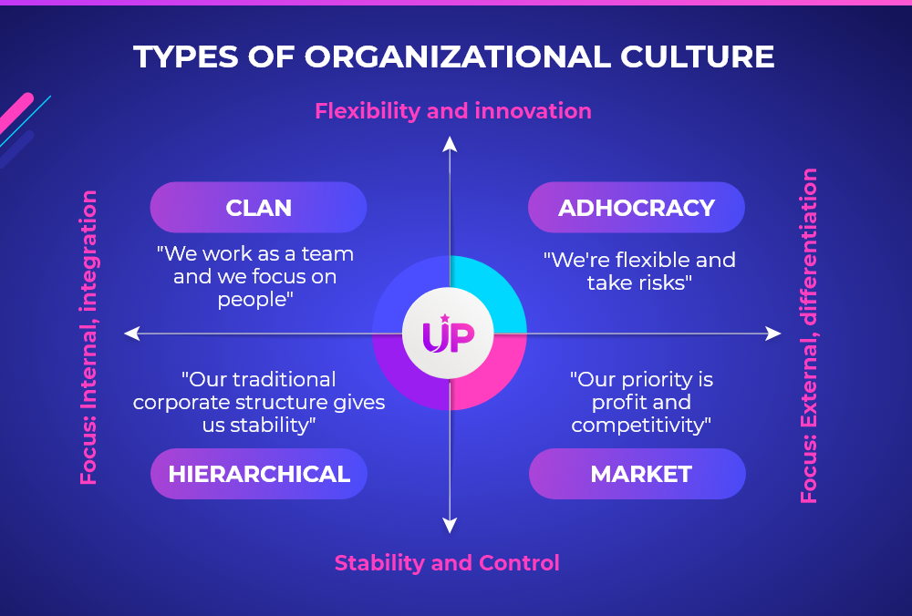
Types of Organizational Culture
.
Notes:
Clan Culture: emphasizes collaboration across teams and a horizontal structure.
Adhocracy Culture: allows individuals to share ideas and encourages the company to take risks.
Market Culture: focuses on financial success and how each employee contributes to revenue.
Hierarchy Culture: emphasizes career paths and provides clear managerial processes.

Slide 31
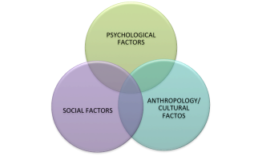
Globalization and Culture
.
As globalization has fostered the thought of multiculturalism, the relationship between culture and organizational behavior has become increasingly valued.
Notes:
Clan Culture: emphasizes collaboration across teams and a horizontal structure.
Adhocracy Culture: allows individuals to share ideas and encourages the company to take risks.
Market Culture: focuses on financial success and how each employee contributes to revenue.
Hierarchy Culture: emphasizes career paths and provides clear managerial processes.

Slide 32
Diversity
.
Cultural diversity is geared toward having a deep respect and understanding of the various people in the organization.
This organization aspect is strengthened by feedback, teamwork, team-building activities and interpersonal communication.
During such engagements, individuals are able to interact and appreciate each other’s culture; consequently, an accommodating culture and organizational behavior is established within the organization.
.
Notes:
Clan Culture: emphasizes collaboration across teams and a horizontal structure.
Adhocracy Culture: allows individuals to share ideas and encourages the company to take risks.
Market Culture: focuses on financial success and how each employee contributes to revenue.
Hierarchy Culture: emphasizes career paths and provides clear managerial processes.

Slide 33
Globalization and Leadership
.
Leadership might be universal in terms of a kind of social process but that the content of leadership was affected by the culture.
Different cultures would lead to different contents, styles and effectiveness of leadership.
In most situations, leadership styles might not reveal leaders’ personal will, but reflect the culture and tradition of the societies they are in.
Moreover, the effectiveness of leadership would also be influenced by local social context. For example: Defining, measuring and rewarding performance in the same way does not work well across functions, business units and occupations.
.
Notes:
Clan Culture: emphasizes collaboration across teams and a horizontal structure.
Adhocracy Culture: allows individuals to share ideas and encourages the company to take risks.
Market Culture: focuses on financial success and how each employee contributes to revenue.
Hierarchy Culture: emphasizes career paths and provides clear managerial processes.

Slide 34
Importance of OB in understanding Human behaviour
.
Impact of Personality on performance
Employee motivation
Leadership
Perception
Individual behavior
Attitude
Management of Change
Management of Stress and Conflict
Organizational development

Slide 35
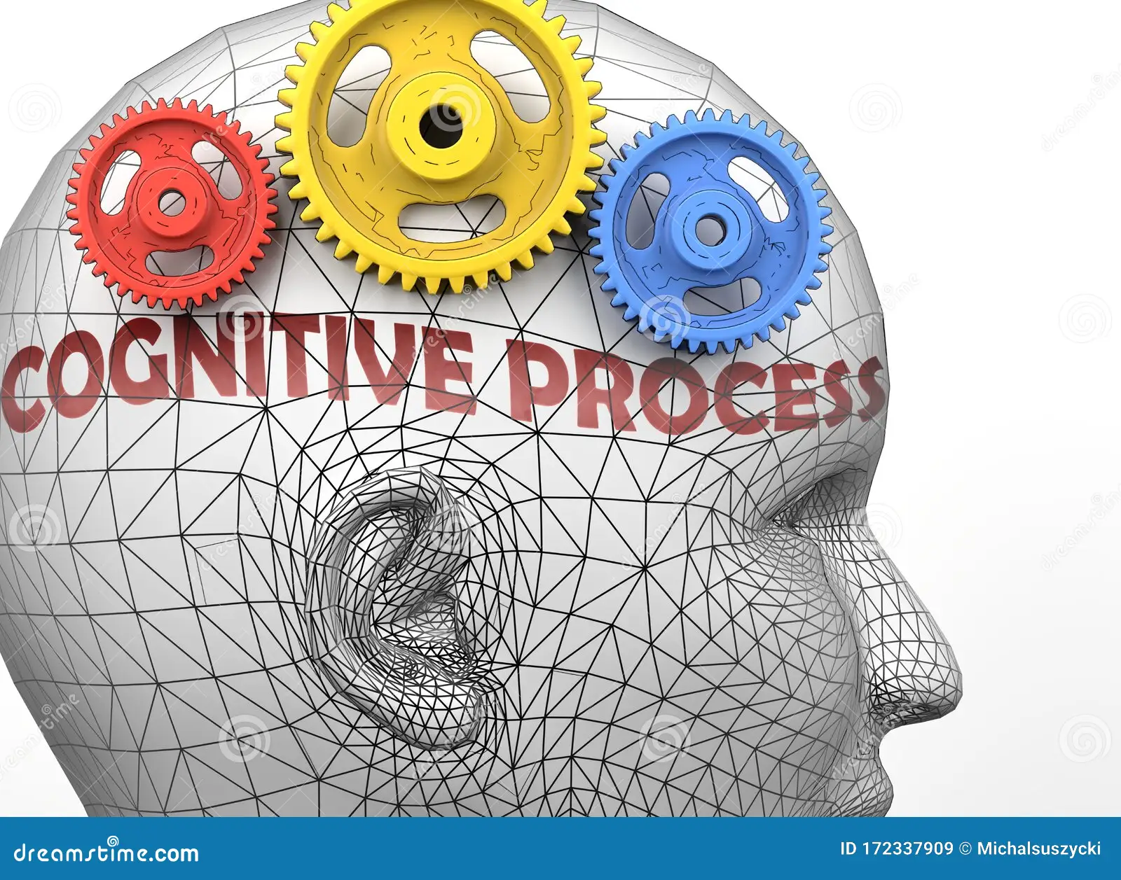
Cognitive processes
. Cognitive processes refer to the mental activities and functioning of the brain involved in acquiring, processing, storing, and applying knowledge and information.

Slide 36
Types of Cognitive Processes
Attention
Language
Learning
Memory
Perception
Thought
Notes:
Attention
Attention is a cognitive process that allows people to focus on a specific environmental stimulus. Attention is an important cognitive ability because it allows us to focus on the information we need, while also filtering out irrelevant distractions.
Language
Language and language development are cognitive processes that involve the ability to understand and express thoughts through spoken and written words. This allows us to communicate with others, including conveying our own thoughts and learning about others. It also plays an important role in thought.
Learning
Learning requires cognitive processes involved in taking in new things, synthesizing information, and integrating it with prior knowledge. Cognitive psychologists often study the mental processes that involved in processing, comprehending, and remembering information.
Memory
Memory is an important cognitive process that allows people to encode, store, and retrieve information. It is a critical component in the learning process and allows people to retain knowledge about the world and their personal histories.
Perception
Perception is a cognitive process that allows people to take in information through their senses, then utilize this information to respond and interact with the world.
Thought
Thought is an essential part of every cognitive process. It allows people to engage in decision-making, problem-solving, and higher reasoning.

Slide 37
Perception
Perception is a cognitive process that allows people to take in information through their senses, then utilize this information to respond and interact with the world.
Perception is the process of receiving information and making sense of the world around us. It involves deciding which information to notice, how to categorize this information and how to interpret it within the framework of existing knowledge.

Slide 38
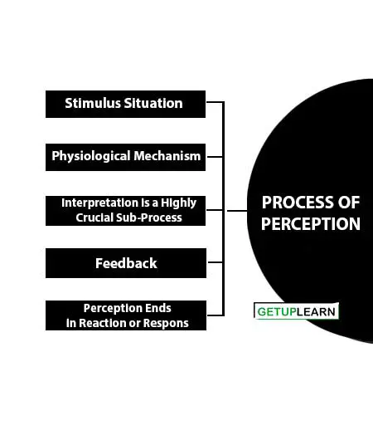
Process of Perception
Notes:
Stimulus Situation
Perception initiates with the presence of a stimulus situation. In organizational settings the superior forms the stimulus situation for the subordinate’s perceptual process.
Physiological Mechanism
Registration involves the physiological mechanism including both sensory and neural. Obviously, an individual’s physiological ability to hear and see influences his perception.
Interpretation is a Highly Crucial Sub-Process
Interpretation is a highly crucial sub-process. Other psychological processes assist in perceptual interpretation. For instance, in work settings, motivation, personality, and learning process determine an individual’s interpretation of a stimulus situation.
Feedback
Feedback is important for interpreting perceptual event data. In work settings, the psychological feedback that is likely to affect a subordinate’s perception may be in the form of a variation in the behavior of the superior.
Perception Ends in Reaction or Respons
Perception ends in reaction or response, which may be in the overt or covert form. As a consequence of perception, an individual responds to work demands. These sub-processes indicate the complexity of perception

Slide 39
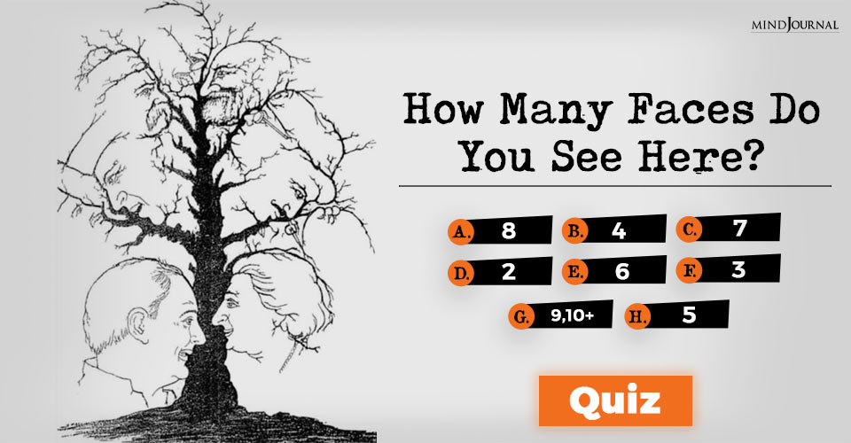
Perception Test
Notes:
Stimulus Situation
Perception initiates with the presence of a stimulus situation. In organizational settings the superior forms the stimulus situation for the subordinate’s perceptual process.
Physiological Mechanism
Registration involves the physiological mechanism including both sensory and neural. Obviously, an individual’s physiological ability to hear and see influences his perception.
Interpretation is a Highly Crucial Sub-Process
Interpretation is a highly crucial sub-process. Other psychological processes assist in perceptual interpretation. For instance, in work settings, motivation, personality, and learning process determine an individual’s interpretation of a stimulus situation.
Feedback
Feedback is important for interpreting perceptual event data. In work settings, the psychological feedback that is likely to affect a subordinate’s perception may be in the form of a variation in the behavior of the superior.
Perception Ends in Reaction or Respons
Perception ends in reaction or response, which may be in the overt or covert form. As a consequence of perception, an individual responds to work demands. These sub-processes indicate the complexity of perception

Slide 40
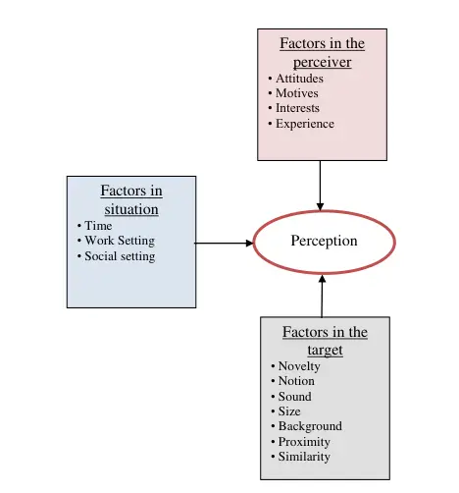
Factors Influencing Perception
Notes:
Perceiver
When an individual looks at a target and attempts to interpret what he or she sees, the interpretation is heavily influenced by the personal characteristics of the individual perceiver. Among the more relevant personal characteristics affecting perception are attitudes, motives, interests, past experiences, and expectations.
Target
The characteristics of the target being observed can affect the perception. Loud people are more likely to be noticed than the quiet ones. There are extremely attractive and unattractive individuals. Motion, Sounds, Size, and other attributes of a target shape the way we see it.
Situation
The context in which we see the objects or events is important. Elements in the surrounding environment influence our perception. One may not notice a 25-year-old female in an evening gown and heavy makeup; yet the same woman, attired for management class would certainly catch attention.

Slide 41
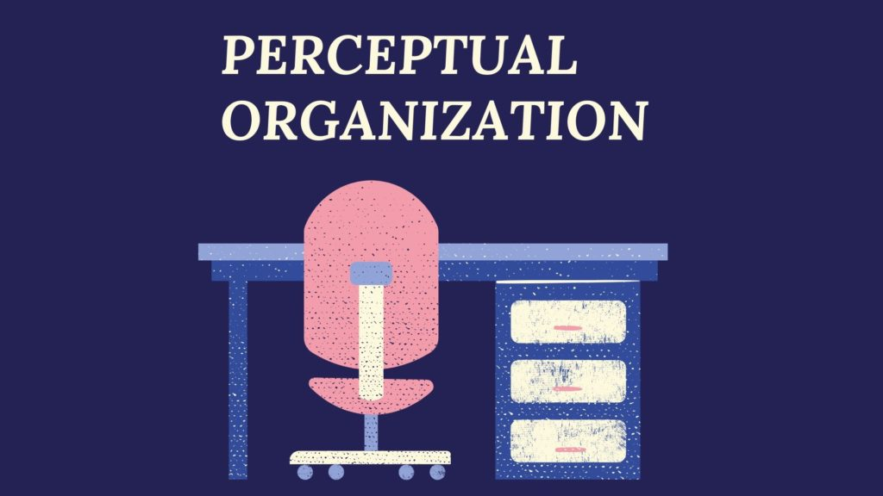
Perceptual Organization
Perceptual organization is concerned with process of organizing the inputs into identifiable whole objects.
A person’s perceptual process organizes the incoming information into meaningful whole.
Notes:
Perceiver
When an individual looks at a target and attempts to interpret what he or she sees, the interpretation is heavily influenced by the personal characteristics of the individual perceiver. Among the more relevant personal characteristics affecting perception are attitudes, motives, interests, past experiences, and expectations.
Target
The characteristics of the target being observed can affect the perception. Loud people are more likely to be noticed than the quiet ones. There are extremely attractive and unattractive individuals. Motion, Sounds, Size, and other attributes of a target shape the way we see it.
Situation
The context in which we see the objects or events is important. Elements in the surrounding environment influence our perception. One may not notice a 25-year-old female in an evening gown and heavy makeup; yet the same woman, attired for management class would certainly catch attention.

Slide 42
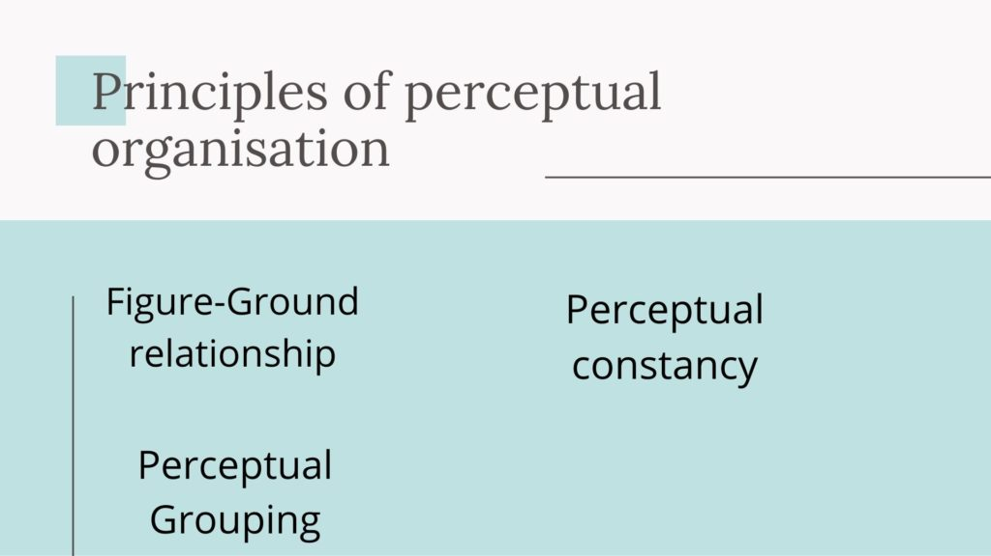
Principles of Perceptual Organization

Slide 43
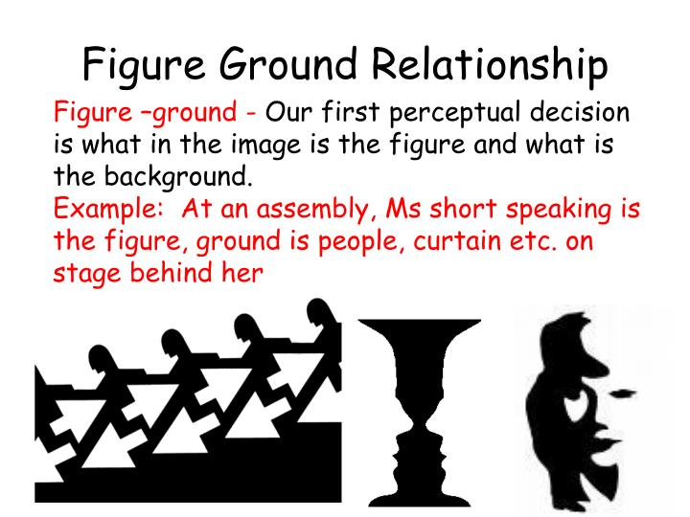

Figure Ground Relationship

Slide 44
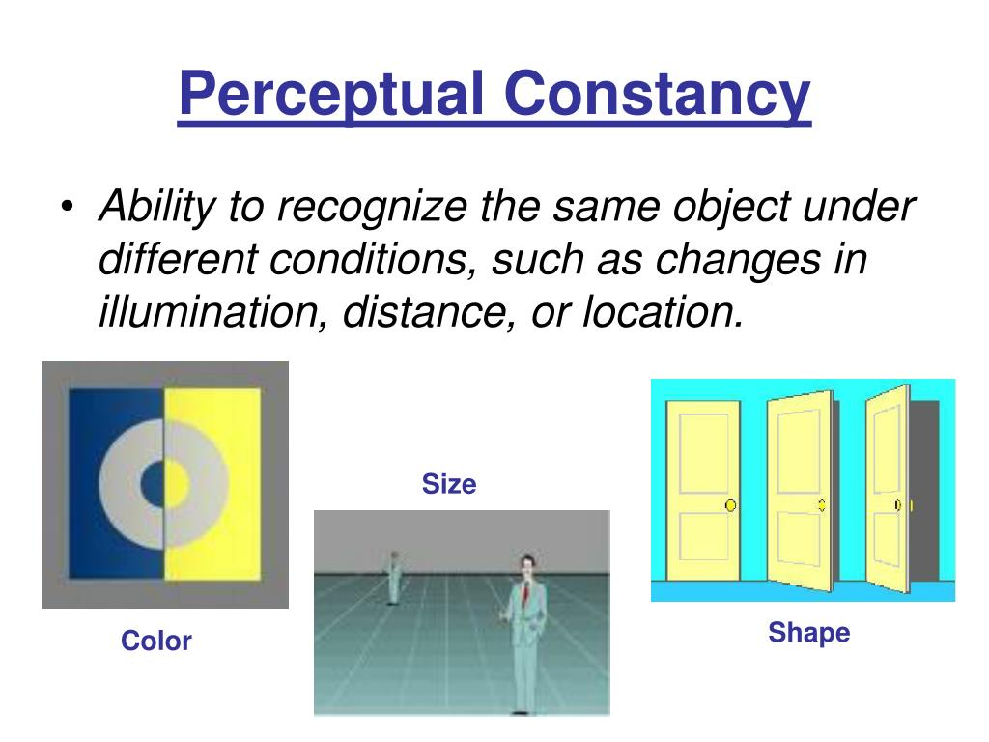
Principles of Perceptual Organization

Slide 45
Errors or Barriers to Perception
Selective perception is a perceptual process in which a person only perceives what he desires to and sets aside or ignores other perceptions or viewpoints.
Halo Effect- The "halo effect" is when one trait of a person or thing is used to make an overall judgment of that person or thing.
is a perceptual process in which a person only perceives what he desires to and sets aside or ignores other perceptions or viewpoints.

Slide 46
Errors or Barriers to Perception
Stereotyping-We always have a tendency to classify people to a general groups /categories in order to simplify the matter. For example-Women are always good homemakers and can do well in work life balance
Contrast Effect-We again sometimes judge people in comparison to others . This example generally found in sports, academics and performance review

Slide 47
Errors or Barriers to Perception
Projection-This is very common among Perceptual errors. Projection of one's own attitude, personality or behavior into some other person. For example- To all honest people, everybody is honest.
Impression-We all know the term "first impression is the last impression" and we apply that too .For example-During the time of hiring, thought like this "The most decent and modest person in the interview can do very well in every roles and responsibilities " always arise.
Attribution is what happens when a person takes the information they perceived and determines a reason as to what happened

Slide 48
Errors or Barriers to Perception
Projection-This is very common among Perceptual errors. Projection of one's own attitude, personality or behavior into some other person. For example- To all honest people, everybody is honest.
Impression-We all know the term "first impression is the last impression" and we apply that too .For example-During the time of hiring, thought like this "The most decent and modest person in the interview can do very well in every roles and responsibilities " always arise.
Attribution is what happens when a person takes the information they perceived and determines a reason as to what happened
Notes:
We can project both negative and positive characteristics, however there is a greater tendency to project the former rather than the latter.
Ex- If a consumer has had bad experience with a locally- made product (and good experience with an imported one) he or she may conclude that the bad product is bad because it is locally made.

Slide 49
Behavioral Implications of Perception
Perception is very important in understanding human behavior because every person perceives the world and approaches life problems differently.
If people behave on the basis of their perception, we can predict their behavior in the changed circumstances by understanding their present perception of the environment.
With the help of perception, the needs of various people can be determined, because people’s perception is influenced by their needs.
Perception is very important for the manager who wants to avoid making errors when dealing with people and events in the work setting.

Slide 50
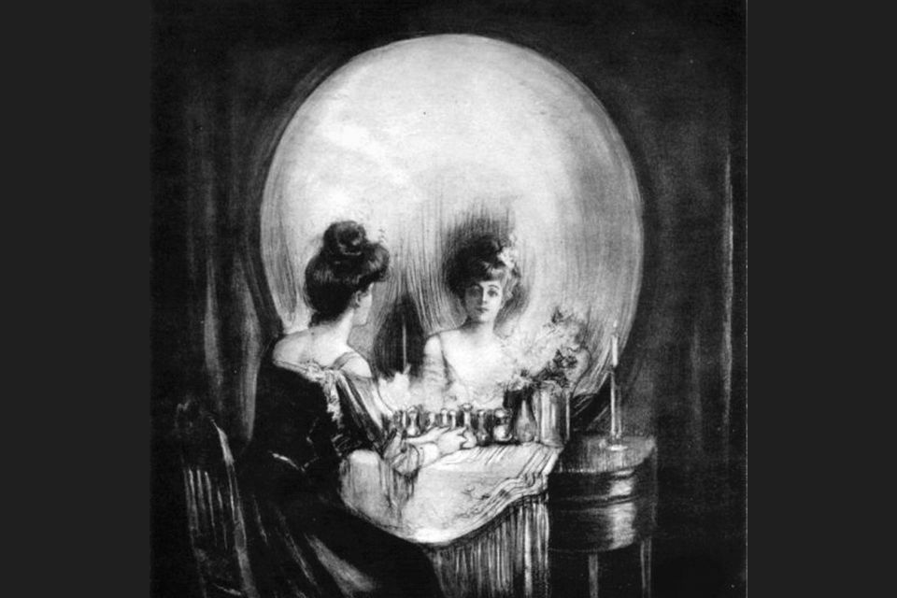
Perception tests

Slide 51

Perception tests

Slide 52
Daily Quiz
Which of the following words does NOT describe perception?
A passive process
A psychological process
No direct contact with the physical world
Using sense organs
Sensation is to ________ as perception is to ________.
a. vision, olfaction
b. conscious, unconscious
c. awareness, interpretation
d. taste, vision

Slide 53
Daily Quiz
Mary is so beautiful, I bet she is smart too. This is an example of :
Stereotyping
Impression
Halo effect
Recency effect
______ prevents you from seeing an individual as an individual rather than a group or community.
a. Recency effect
b. Stereotyping
c. Halo effect
d. Leniency effect

Slide 54
Youtube Video Links
https://courses.lumenlearning.com/waymaker-psychology/chapter/reading-what-is-perception/
https://www.youtube.com/watch?v=uWCcFrnGPBw

Slide 55
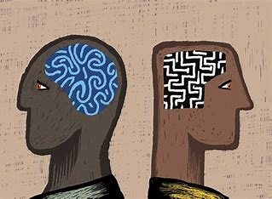
Attribution
Attribution theory, proposed by Fritz Heider (1958), is a social psychology theory that deals with how individuals relate and make sense of the social world.
More specifically, it is concerned with how people translate events around them and how their translations affect their thinking and behavior.

Slide 56
Types of Attribution
External Attribution (Situational Attribution)
Internal Attribution (Dispositional Attribution)

Slide 57
External Attribution
External Attribution (Situational Attribution): Causality is assigned to an outside factor, agent, or force. Outside factors fall outside your control.
You perceive you have no choice. So your behavior is influenced, limited or even completely determined by influences outside your control.
Therefore you feel not responsible.
A generic example is the weather

Slide 58
Internal Attribution
Internal Attribution (Dispositional Attribution): Causality is assigned to an inside factor, agent or force. Inside factors fall inside your own control.
You can choose to behave in a particular way or not. So your behavior is not influenced, limited or even completely determined by influences outside your control.
Therefore you feel responsible. A typical example is your own intelligence.

Slide 59
Locus of Control
Locus of control refers to a person's beliefs about how much control they have over what happens to them in their life and how much influence they have over what happens in the world around them.
Locus of control refers to one’s assumption about responsibility for good and bad events. Every person during his lifetime comes across some good and some had outcomes. While he acts to maximize the possibility of good outcomes and enjoys the success of his life, he tries to minimize the possibility of bad outcomes.

Slide 60
Locus of Control-Types
(1) Internal Locus of control
(2) External Locus of control.

Slide 61
Internal Locus of Control
Internal locus of control means that control comes from within. You have personal control over your own behavior.
When you have an internal locus of control, you believe you have personal agency over your own life and actions. Because of this, these people tend to have more self-efficacy.

Slide 62
External Locus of Control
External locus of control means that control stems from external forces. When you have an external locus of control, you believe that events outside of your control drive your actions and the outcomes you get.
Those who are always at the mercy of luck, fate and unforeseen uncontrollable outside force and feel helpless all the time and never like to take the responsibility for their bad outcomes and miserable performances in life are said to have external locus of control.

Slide 63
Youtube links
https://www.youtube.com/watch?v=f_S_bapYEm4
https://www.youtube.com/watch?v=GW2A8xoSoYk

Slide 64
Daily Quiz
1. Sathish has a low absenteeism rate. He takes responsibility for his health and has good health habits. He is likely to have a(an):
a. Internal locus of control
b. External locus of control
c. Core locus of control
d. High emotional stability level
2. Some people strongly believe that each person have control of his own life. This is
a. extroversion
b. conscientiousness
c. internal locus of control
d. external locus of control

Slide 65
Daily Quiz
3. If a person responds the same way over time, attribution theory states that the behaviour shows.
a. Distinctiveness
b. Consensus
c. Consistency
d. continuity
4. Mr.Balu is late for work each day by about ten minutes. How would attribution theory describe this behaviour?
a. It shows consensus.
b. It shows similarity.
c. It shows reliability.
d. It shows consistency

Slide 66
Weekly Assignment
Define OB. Discuss its nature and scope.
Discuss the impact of Globalization and diversity on Organizational behavior.
Explain the implications of Perception on managerial decision making.
Differentiate between Internal and External Locus of Control.

Slide 67
MCQ s
Which behavioural science discipline is most focused on understanding individual behaviour?
Sociology
social psychology
Psychology
anthropology
2. The science that seeks to measure, explain, and sometimes change the behaviour of humans and other animals is known as .
Psychiatry
Psychology
Sociology
organizational behavior

Slide 68
MCQ s
Which behavioural science discipline is most focused on understanding individual behaviour?
Sociology
social psychology
Psychology
anthropology
2. The science that seeks to measure, explain, and sometimes change the behaviour of humans and other animals is known as .
Psychiatry
Psychology
Sociology
organizational behavior

Slide 69
MCQ s
3. Organization Behavior is
An interdisciplinary approach
A humanistic approach
Total system approach
All of these
4. Organization Behavior is not a /an
A separate field of study
Applied science
Normative science
Pessimistic approach

Slide 70
MCQ s
5. The cognitive process through which an individual selects, organizes but misinterprets environmental stimuli is known as_________
Perception
Projection
Selective Perception
Mis-Perception
6. What is the process by which individuals organize and interpret their sensory impressions in order to give meaning to their environment?
Interpretation
environmental analysis
Outlook
perception

Slide 71
Expected Questions for University Exam
What is organizational behavior?
What are the major behavioural science disciplines that contribute to OB?
What is the link between perception and decision making? How does one affect the other?
What are some of the common decision biases or errors that people make?
What are the influences of individual differences, organizational constraints, and culture on decision making?
Discuss the nature and scope of OB.
Discuss the impact of Globalization and diversity on Organizational behavior.
Explain the implications of Perception on managerial decision making.
Differentiate between Internal and External Locus of Control.
10. Explain the Attribution theory.

Slide 72
Recap of the Unit
This topic tells us about the subject of Organizational behavior and the disciplines contributing to it. We also discussed about the cognitive process- perception, its process and the various perceptual errors. The unit also explain the Attribution theory and the Locus of control.

Slide 73
References
1.Robbins Stephen P& Judge Timothy A. ―Organizational Behaviour (Pearson)
2. Pareek Udai :Understanding Organizational Behaviour, (Oxford University Press, 4th Edition, 2016)
3. Luthans Fred : Organizational Behaviour, (McGraw Hill International Edition, 12th Edition,2013)

